Slide 1
Space Runner
Nicholas Soffa
April 24th, 2017

Slide 2
Description
Space Runner is a 2D side scrolling platforming game. The player controls a space marine, fighting to survive in never-ending corridors of enemies and traps.
The space marine can also travel back and forth between two linked versions of these randomly generated hallways.
Collect as many purple gems as you can and compete to get the high score!

Slide 3
Goals
Create a resume-worthy game with C# and Unity v5.4
Gain more experience with game design
Gain more experience with the game design pipeline

Slide 4
Justification
My career path
Space Runner is a good scale
LMU Curriculum

Slide 5
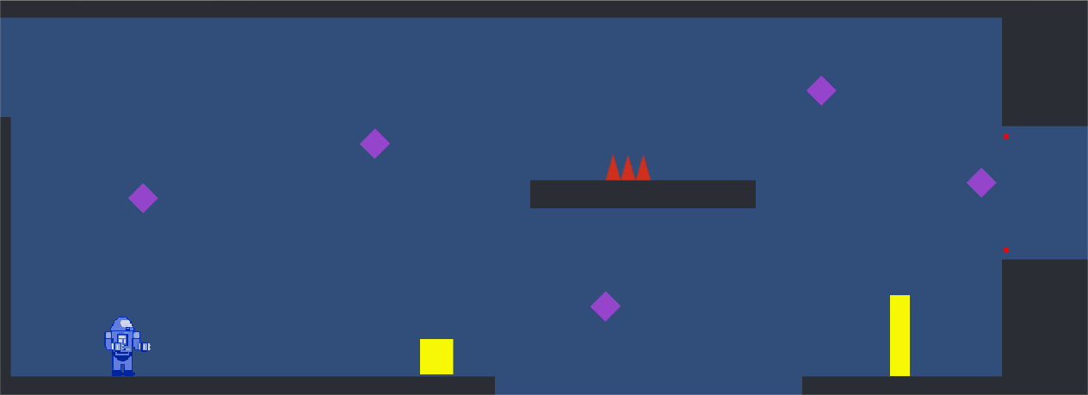
Interface

Slide 6
Demonstration

Slide 7
Challenges
Character Movement
Enemy AI
Swapping Level Tracks
Art

Slide 8
Status
Music & Sound Effects
Main Menu & Pause Menu
User Interface

Slide 9
Questions?

